Slide 1
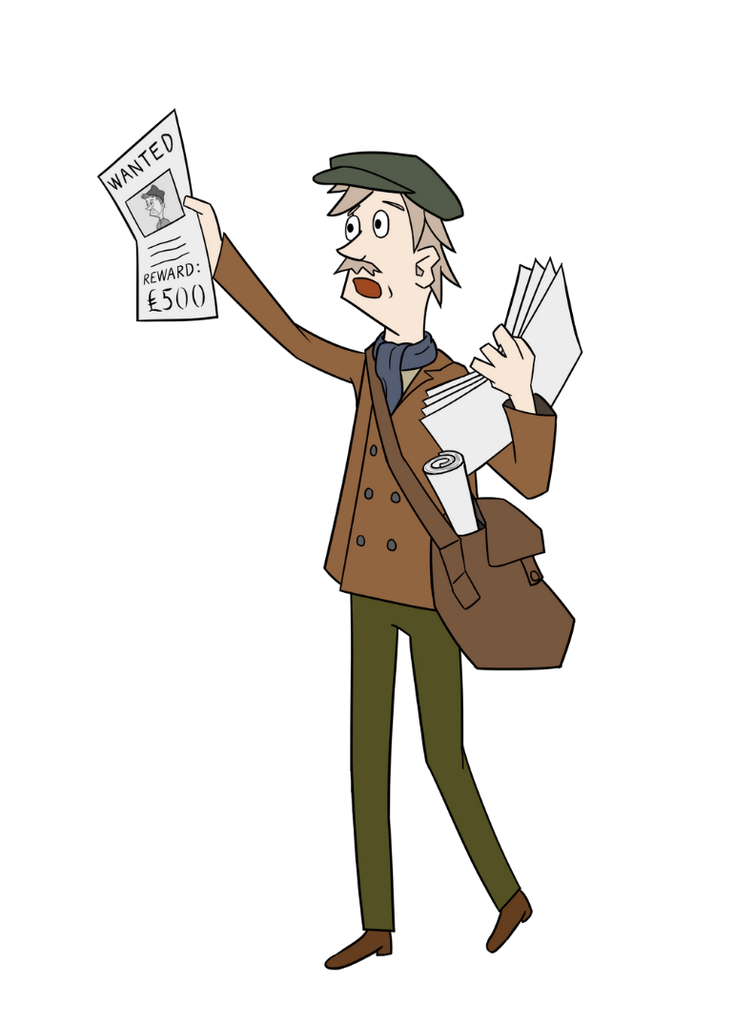



Reward Posters – Title Page
Reward Posters
What were they?​
Who created them?​
Why were they needed?​

Slide 2
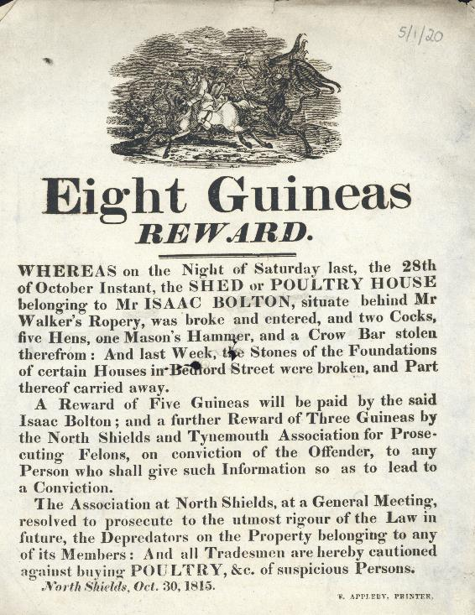
Reward Posters - 1
Reward Posters
The first police force in Newcastle was not created until 1836. ​Before this it was usually the responsibility of the individual (mostly the victim of a crime) to get justice. ​Sometimes people set up community groups known as Prosecution Associations. ​
Reward Poster 1815, Broadsides 5/1/20, Broadsides, Newcastle University Special Collections, GB186

Slide 3
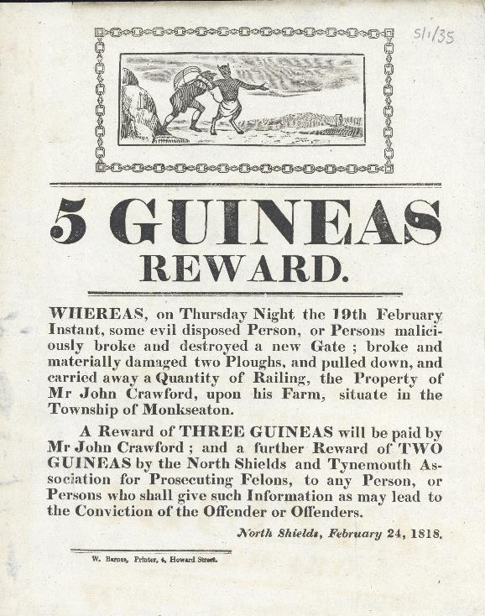
Reward Posters - 2
Reward Posters
Members of these groups paid money to cover the cost of private prosecutions (legal action against a criminal). Individuals and/or the Prosecution Associations often paid for posters to be printed and displayed around their local area, in order to bring a criminal to justice. ​
Reward Poster 1818, Broadsides 5/1/35, Broadsides, Newcastle University Special Collections, GB186

Slide 4
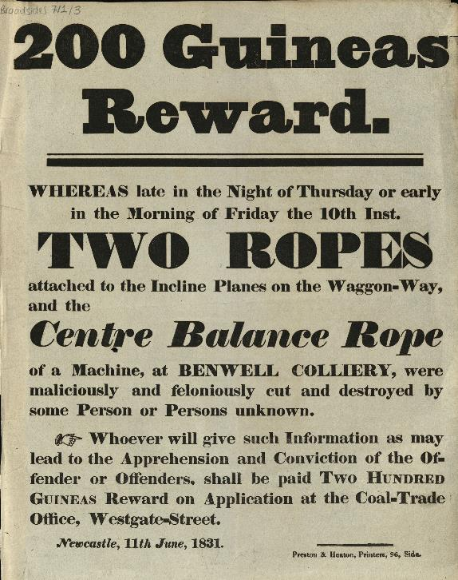
Reward Posters - 3
Reward Posters
The posters offered a reward (money) to anyone who had information about the crime.
Reward Poster 1831, Broadsides 5/1/3, Broadsides, Newcastle University Special Collections, GB186

Slide 5
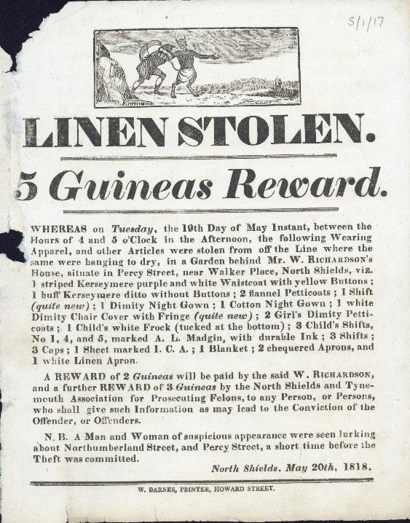
Example of a Reward Poster - 1
Example of a Reward Poster
1 What is this document and what does it tell you?
2 What crime has been committed?
3 What reward is being offered?​
Reward Poster 1818, Broadsides 5/1/17, Broadsides, Newcastle University Special Collections, GB186

Slide 6
Example of a Reward Poster - 2
Example of a Reward Poster
1 What is this document and what does it tell you?
This is a Reward Poster which was created to find information about a crime that has been committed. ​
The poster explains a crime has been committed and that a reward is being offered to anyone who has information.
2 What crime has been committed?
Someone has stolen some items of clothing from a washing line.
3 What reward is being offered?​
5 Guineas
Reward Poster 1818, Broadsides 5/1/17, Broadsides, Newcastle University Special Collections, GB186

Slide 7
Example of a Reward Poster 3
Example of a Reward Poster
4 Where was this poster printed? ​
5 Where did the crime take place?
6 When was this poster published?
Reward Poster 1818, Broadsides 5/1/17, Broadsides, Newcastle University Special Collections, GB186

Slide 8
Example of a Reward Poster 4
Example of a Reward Poster
4 Where was this poster printed? ​
North Shields
5 Where did the crime take place?
Perry Street, near Walker Place in North Shields.
6 When was this poster published?
May 20th 1818
Reward Poster 1818, Broadsides 5/1/17, Broadsides, Newcastle University Special Collections, GB186

Slide 9
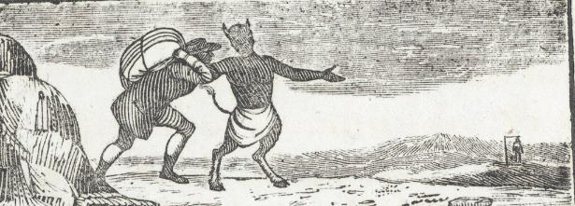
Example of a Reward Poster 5
Example of a Reward Poster
7 What can you see in this image from the top of the poster?​
8 What does this image suggest?​
Reward Poster 1818, Broadsides 5/1/17, Broadsides, Newcastle University Special Collections, GB186

Slide 10
Example of a Reward Poster 6
Example of a Reward Poster
7 What can you see in this image from the top of the poster?​
Dancing Devil​
Criminal being dragged along the path by the devil​
In the distance is a criminal who has been hung​
8 What does this image suggest?​
It suggests that the devil is leading the man to commit a crime. The picture of the man hanging from the gallows in the distance suggests that this will be this mans future if he continues down this path.
Reward Poster 1818, Broadsides 5/1/17, Broadsides, Newcastle University Special Collections, GB186

Slide 11


Ending Slide
Newcastle University Library
Explore the Possibilities
ncl.ac.uk/library

