Slide 1

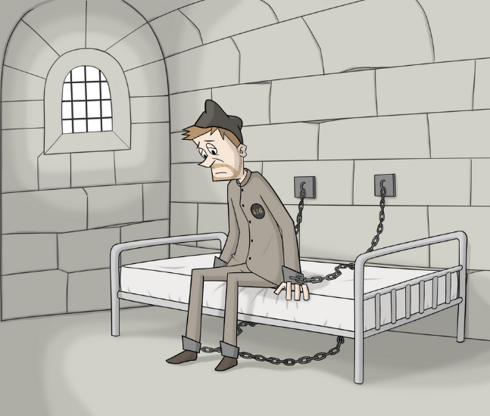


Newcastle Gaol: An Overview
Newcastle Gaol:
An Overview
This presentation is based on information from the Newcastle Gaol Project: Newcastle Gaol Project (www.newcastlegaol.co.uk) ​​

Slide 2
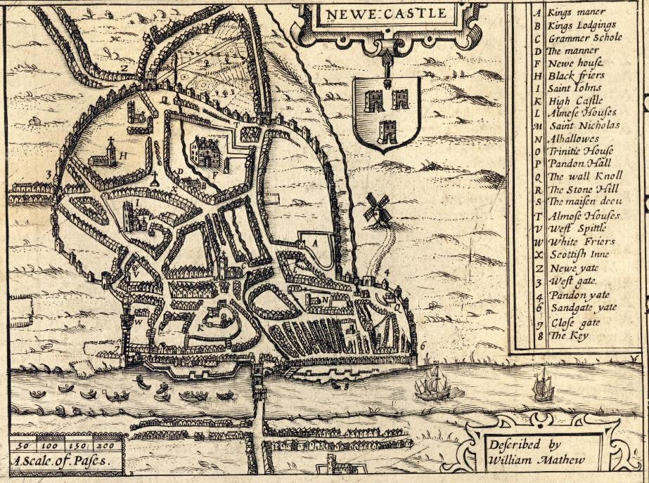
Medieval Newcastle
Medieval Newcastle
In medieval times, Newcastle was a walled town with six major gates.​
A 17th century plan of Newcastle, Post Incunabula, PI 912.42 SPE, Post Incunabula, Newcastle University Special Collections, GB186

Slide 3
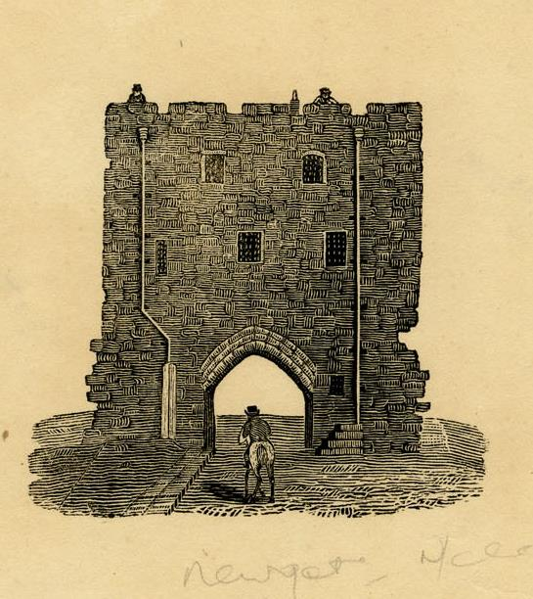
The Medieval Gaol
The Medieval Gaol
In 1399 New Gate, the most heavily fortified of the town gates, became the town gaol.​
​
Prisoners who had been sentenced to death would be taken from New Gate through Gallow Gate to be executed on the Town Moor.​
Newgate, Newcastle 1800-1899 Local Illustrations, ILL/11/131, Local Illustrations, Newcastle University Special Collections, GB186

Slide 4
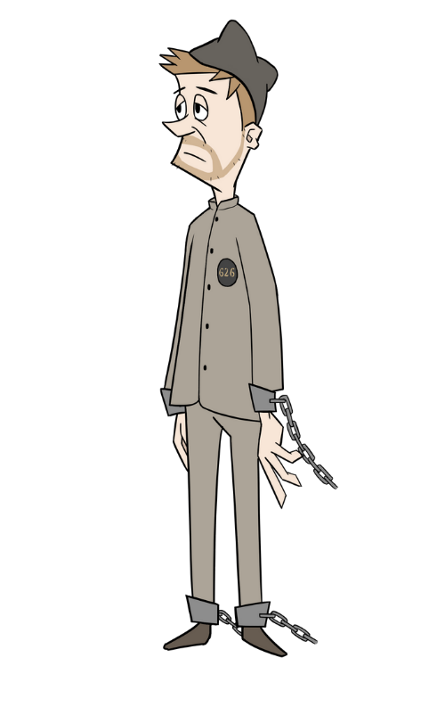
The New Gaol
The New Gaol
By the 1820s New Gate was no longer fit for purpose.​
​
In 1822, the authorities in Newcastle were given permission to build a new gaol on land at Carliol Croft.​
​
John Dobson was chosen as the architect.​

Slide 5
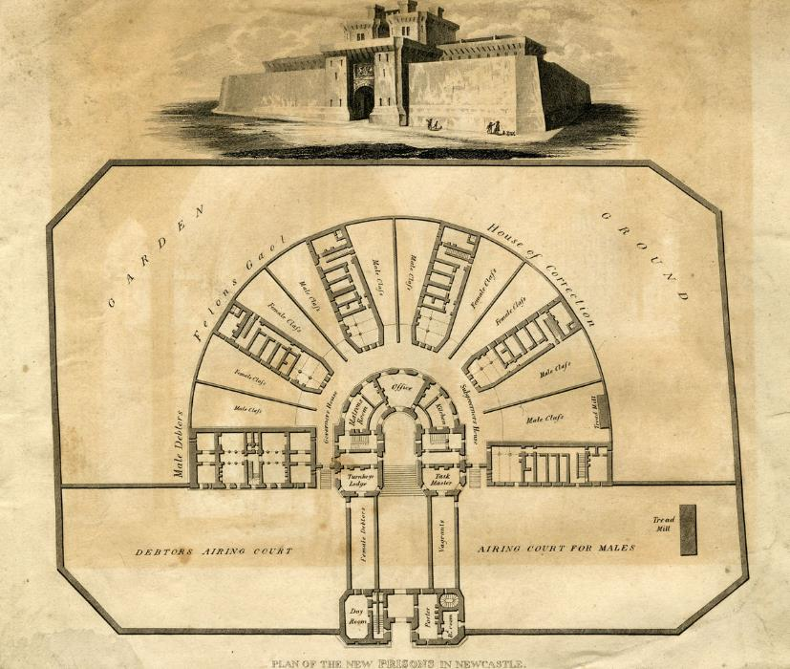
The Design
The Design
John Dobson’s design was based on Jeremey Bentham’s panopticon prison.​
​
‘Panoptes’ is a Greek word for ‘all-seeing’​
​
The circular design meant that the prison keepers would be able to see what was going on all the time.​
Plan of the new prisons in Newcastle 1800-1899 Local Illustrations, IL/11/227, Local Illustrations, Newcastle University Special Collections, GB186

Slide 6
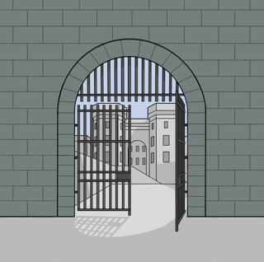
Newcastle Gaol
Newcastle Gaol
Newcastle Gaol took 5 years to build and opened to its first prisoners in February 1829.​
It housed men, women and children who had been convicted of all sorts of crimes.​
Many of the prisoners had been convicted of theft of personal property – crimes which would be considered fairly minor today.​
You can find out more about Newcastle Gaol, its prisoners, and prison life on the Newcastle Gaol website: www.newcastlegaol.co.uk.
​
Newcastle Gaol was closed in 1925 and then demolished.​

Slide 7


Ending Slide
Newcastle University Library
Explore the Possibilities
ncl.ac.uk/library

