Slide 1

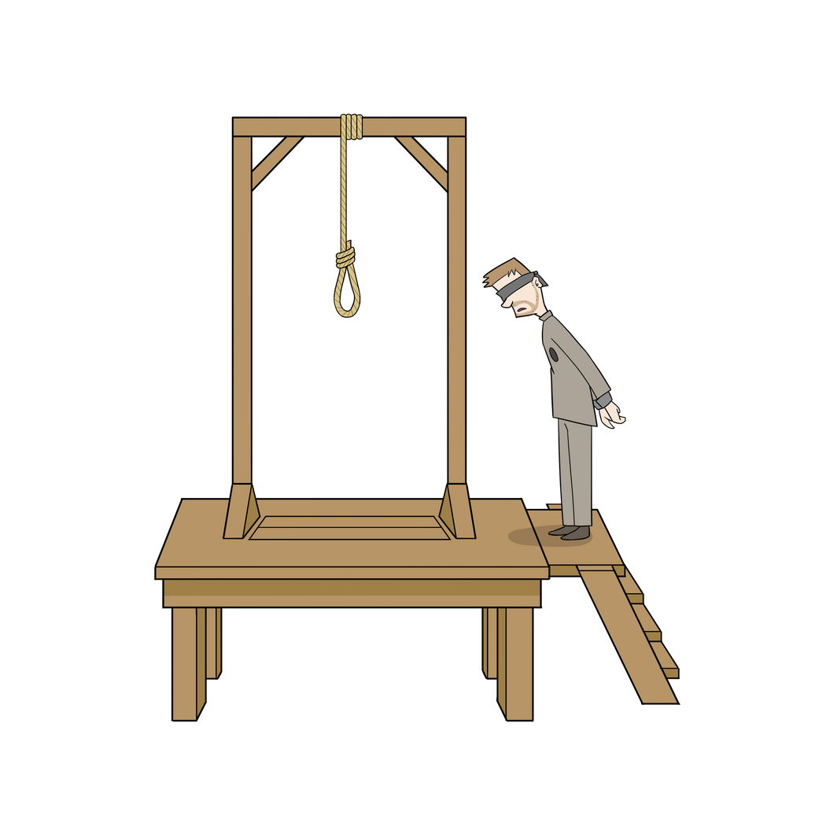
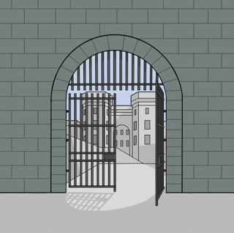
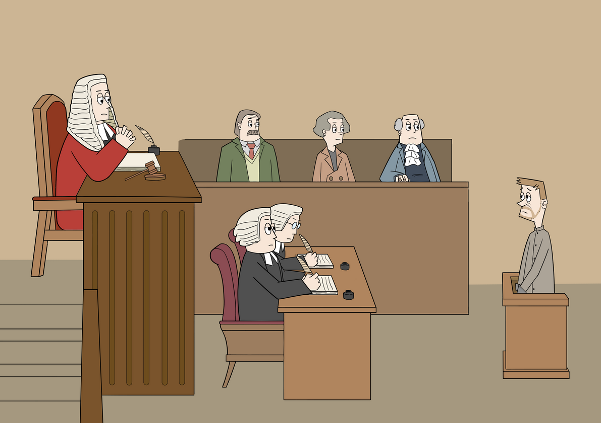


Deterrents to Crime
Deterrents
to Crime
What measures were used to deter people
from committing crimes?​

Slide 2
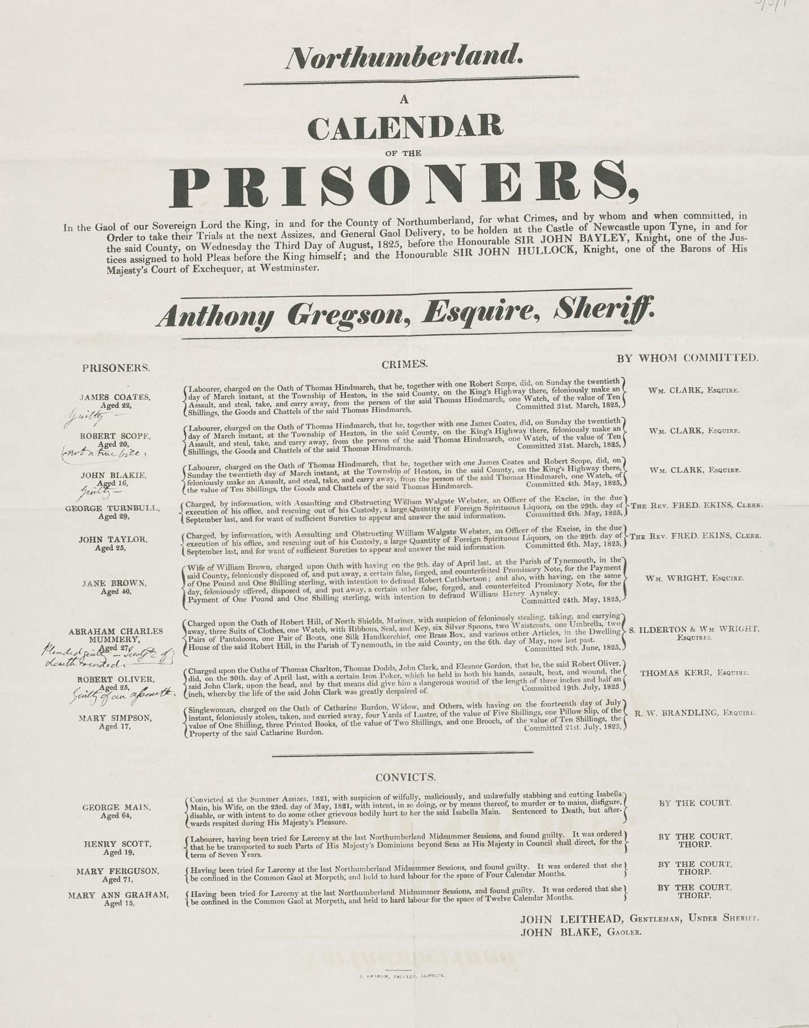
Harsh Punishments
Harsh Punishments
The harsh punishments you were likely to receive for committing a crime acted as a deterrent.​
​
As well as being sent to prison, criminals in 19th century Britain could be transported to Australia or face the death penalty.​
​
The notes in the margin of this Calendar of Prisoners recording prisoners awaiting trail in Northumberland in 1825 indicate that Abraham Charles Mummery, aged 27, who pleaded guilty to stealing clothing, a watch and other items was sentenced to death.
A Calendar of Prisoners 1825, Broadsides 5/3/1, Broadsides, Newcastle University Special Collections, GB186

Slide 3
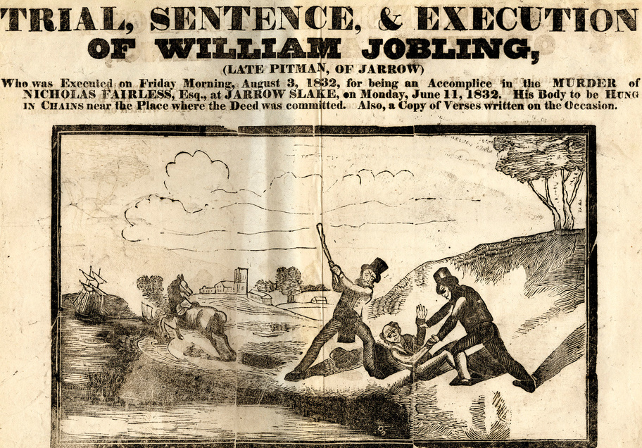
Broadside (Posters)
Broadside (posters)
Broadsides (posters) were used to inform the public about crimes committed and the punishments criminals received.​
These were intended to prevent (deter) people from committing crimes, by making them aware of the harsh punishments they would receive. ​
This Broadside explains the case of William Jobling who was found guilty of being an accomplice in the murder of Nicholas Fairless in June 1832. ​
The judge sentenced him to hang and his dead body to be hung in chains near the site of the murder for all to see. ​
On August 3rd 1832 William Jobling was executed in Jarrow. ​
Trial, sentence and execution of William Jobling 1832, Broadsides 5/2/1, Broadsides, Newcastle University Special Collections, GB186

Slide 4
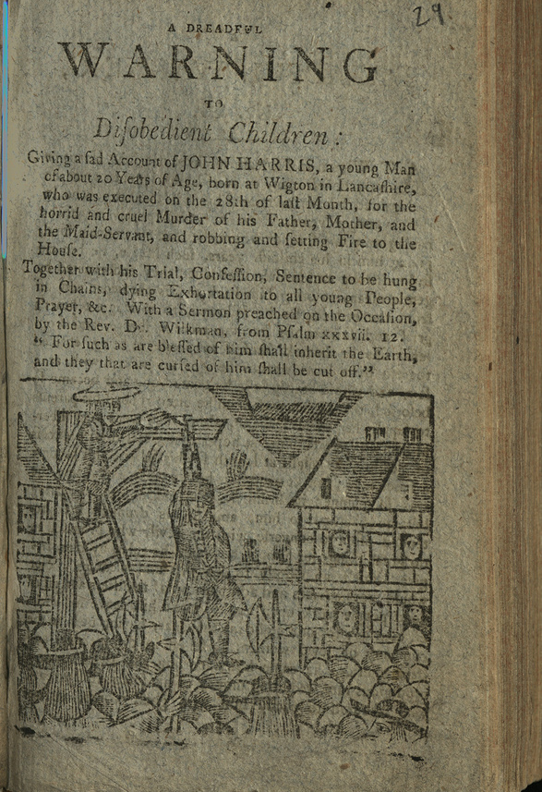
Stories
Stories
Chapbooks (small pamphlets) were also used to inform the public about crimes committed and the punishments received.
Chapbooks were cheap to buy from people on the street and would be read by children as well as adults.
This page is from a chapbook which was created to prevent (deter) people from committing crimes by telling the story of a young man who was executed for murder, robbery and arson. ​
A Dreadful Warning to Disobedient Children, 1800-1899, Chapbooks v. 36 (29), Chapbooks, Newcastle University Special Collections, GB186

Slide 5


Ending Slide
Newcastle University Library
Explore the Possibilities
ncl.ac.uk/library

